Slide 1
Charlie and the Chocolate Factory
Week 2
Storyboard
Notes:
Screen Name: Opening/Cover for the Week
Screen Number: 01
Location: within the LMS
In this module students will:
Read Chapters 3 & 4 of the novel
Add a minimum of 5 words to their word journal in the discussion board
Choose an assignment to complete
Navigation:
Let’s Go button will take you to slide 2
Interaction:
Multimedia:
Script/Notes:

Slide 2
Charlie and the Chocolate Factory
Week 2
Video introduction for week 2
(Teachers script in notes)
Notes:
Screen Name: Introduction to Week 2
Screen Number: 02
Location: within the LMS
Navigation:
Next button will take the leaner to screen number 03
Interaction:
The learner will be able to stop, pause, forward and rewind the introduction video
The leaner will be able to click next to move to screen number 03
There is no need for the learner to go back, so no back button was included
Multimedia:
Video of the facilitator introducing this week's material and assignments
Close caption will be used for the video narration
Script/Notes:
Welcome Back! I hope you are enjoying the book so far. This week you will be reading Chapters 3 & 4.
Make sure to look over the guided reading page to help you focus on important points of the story. Remember to add at least 5 words to your word journal in the discussion board.
Activities for this week are:
#1 Draw a picture of Charlie Bucket and write a character analysis. The character analysis should include a description of what you think Charlie looks like. Please do not describe the characters in the movies. Close your eyes and picture Charlie from the description in the book. What do YOU think he looks like. What kind of personality does Charlie have? Use at least 5 words in each section to describe Charlie. Use the Character Analysis Wheel on the Assignments page to complete your description.
#2 Draw a picture and write a brief description of Prince Pondicherry’s Palace. Explain why or why not it was a good idea to build the palace the way he did. Minimum of 5 sentences.
#3 Answer the following question in at least 5 sentences: Why do you think Charlie ate his birthday chocolate slowly?
#4 Create 5 flash cards with similes, metaphors, personification, alliteration, idioms, onomatopoeia, or hyperboles using examples from chapters 1 through 4. The card must contain a quote from the book, the page number, and which form of figurative language it represents.
#5 Take quiz #1 from the test bank. You may only take a total of 4 quizzes during the semester. The other weeks must be a different activity.
Pick an activity to complete this week. Be ready to share your activity with the class on Monday. If you have any questions about the activities, please send me an email with a good time to give you a call.

Slide 3
Charlie and the Chocolate Factory
Week 2
Where would you like to go?
(select an image)
Read
Chapters
3 & 4
Class meeting space
Notes:
Screen Name: Week 2 Menu
Screen Number: 03
Location: within the LMS
Navigation:
Back button will return the leaner to screen 02
Next button will take the learner to screen 04 if they want to follow a linear pattern of navigation
“Read Chapters 3 & 4” is a static image and for information only
“Syllabus” will take the leaner to the syllabus
“Assignment” will take the leaner to the assignments page on screen 06
“Word Journal” will take the leaner to the discussion board
“Class Meeting space” will take the learner to the online meeting room
“Guided Reading” will take the learner to the guided reading page on screen 04
“In case you missed it” will take the learner to the make up work page on screen 05
Interaction:
The learner may select one of the images on the page to go to the area of their choice
The learner may select “next” to go to the next screen in a linear progression
The learner may select “back” to return to the previous screen 02
Multimedia:
Voice of the instructor only
Closed caption will be used for the narration
Script/Notes:
Please select the area you would like to explore. If you hover over an image it will explain where that image will take you.
(if the learner hovers over the image, the voice will say the following)
The book is just for your information and is not ‘clickable’
The Assignment button will take you to the assignments page
The Word journal button will take you to the discussion board
The Guided Reading button will take you to the Guided reading page
The Syllabus button will take you to the syllabus page
The Class Meeting space button will take you to the meeting room
The “In case you missed it” button will take you to make up assignments page

Slide 4
Charlie and the Chocolate Factory
Week 2
Chapters 3 & 4
Please read through these questions and keep them in mind while reading the chapters:
Why is it strange that nobody ever comes out of Willy Wonka’s factory?
What do we learn about Prince Pondicherry’s personality from the story?
What technique does Roald Dahl use at the end of Chapter 3 to encourage the reader to keep reading?
The owners of the other chocolate factories have unusual names. Why do you think Roald Dahl has chosen these interesting words?
Do you think all Grandpa Joe’s stories are true? Why or why not?
Who do you think is working in the factory? What kind of characters?
Notes:
Screen Name: Guided Reading
Screen Number: 04
Location: within the LMS
Navigation:
Back button will return the leaner to screen 03: Weekly menu page
Next button will take the learner to screen 06: the assignments page
Interaction:
Learner can use the next and back buttons to navigate
Multimedia:
none
Script/Notes:
This page is intended to provided instructional support and guidance to learners that are not in the classroom. By reading these questions prior to reading the chapters students will be able to read for meaning, call up prior reading, and to create an interest in the chapters. This will also allow them to actively participate in the discussion during the synchronous class meeting.

Slide 5
Charlie and the Chocolate Factory
Week 2
If you missed this weeks online meeting, please do the following work and submit it to the Week 2 Dropbox:
Write a one-page summary of chapters 3 and 4. Make sure to explain the following points of the chapter:
Characters in the chapter
who are they
why are they important to the story
their relationship to the main character
Setting
where did this part of the story take place? Please be descriptive
Main points of the chapter
what happened?
What did the reader learn?
Why is this chapter important to the story
Write a sentence with 5 vocabulary words from chapters 3 & 4. (These should be words you have included in your word journal and defined already)
Notes:
Screen Name: “In case you missed it….” Make up assignments
Screen Number: 05
Location: within the LMS
Navigation:
Back button will return the leaner to screen 03: Weekly menu page
Next button will take the learner to screen 06: the assignments page
Interaction:
Learner can use the next and back buttons to navigate
Multimedia:
none
Script/Notes:
This page gives instructions to students who missed the synchronous meeting for make up work.

Slide 6
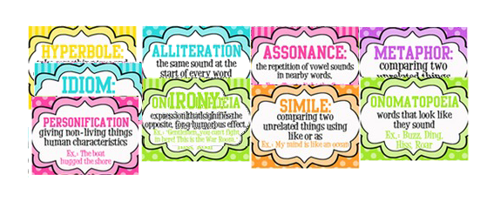
Charlie and the Chocolate Factory
Activities:
Week 2
Activity: (Click on the activity for more instructions) | Description
#1 Character Analysis: | Draw a picture of Charlie Bucket and write a character analysis.
#2 Visualization: | Draw a picture and write a brief description of Prince Pondicherry’s Palace.
#3 Key Ideas: | Why do you think Charlie ate his birthday chocolate slowly?
#4 Figurative Language: | Create 5 flash cards with similes, metaphors, personification, alliteration, idioms, onomatopoeia, or hyperboles using examples from chapters 1 through 4.
#5 Quiz: | Take Quiz #1 in the test bank.
Notes:
Screen Name: Week 2 assignments
Screen Number: 06
Location: within the LMS
Navigation:
Back button will return the leaner to screen 03: Weekly menu page
Next button will take the learner to screen 13 The end of the week
#1 Character Analysis will take the learner to screen 07 for the full assignment
#2 Visualization will take the learner to screen 08 for the full assignment
#3 Key Ideas will take the learner to screen 09 for the full assignment
#4 Figurative Language will take the learner to screen 10 for the full assignment
#5 Quiz will take the learner to screen 11 for the full assignment
Interaction:
Learner can use the next and back buttons to navigate
Learners can click on any of the assignments to be take to the full assignment page
Multimedia:
none
Script/Notes:
This screen is a menu for the weekly assignments with an abbreviated definition of each assignment

Slide 7
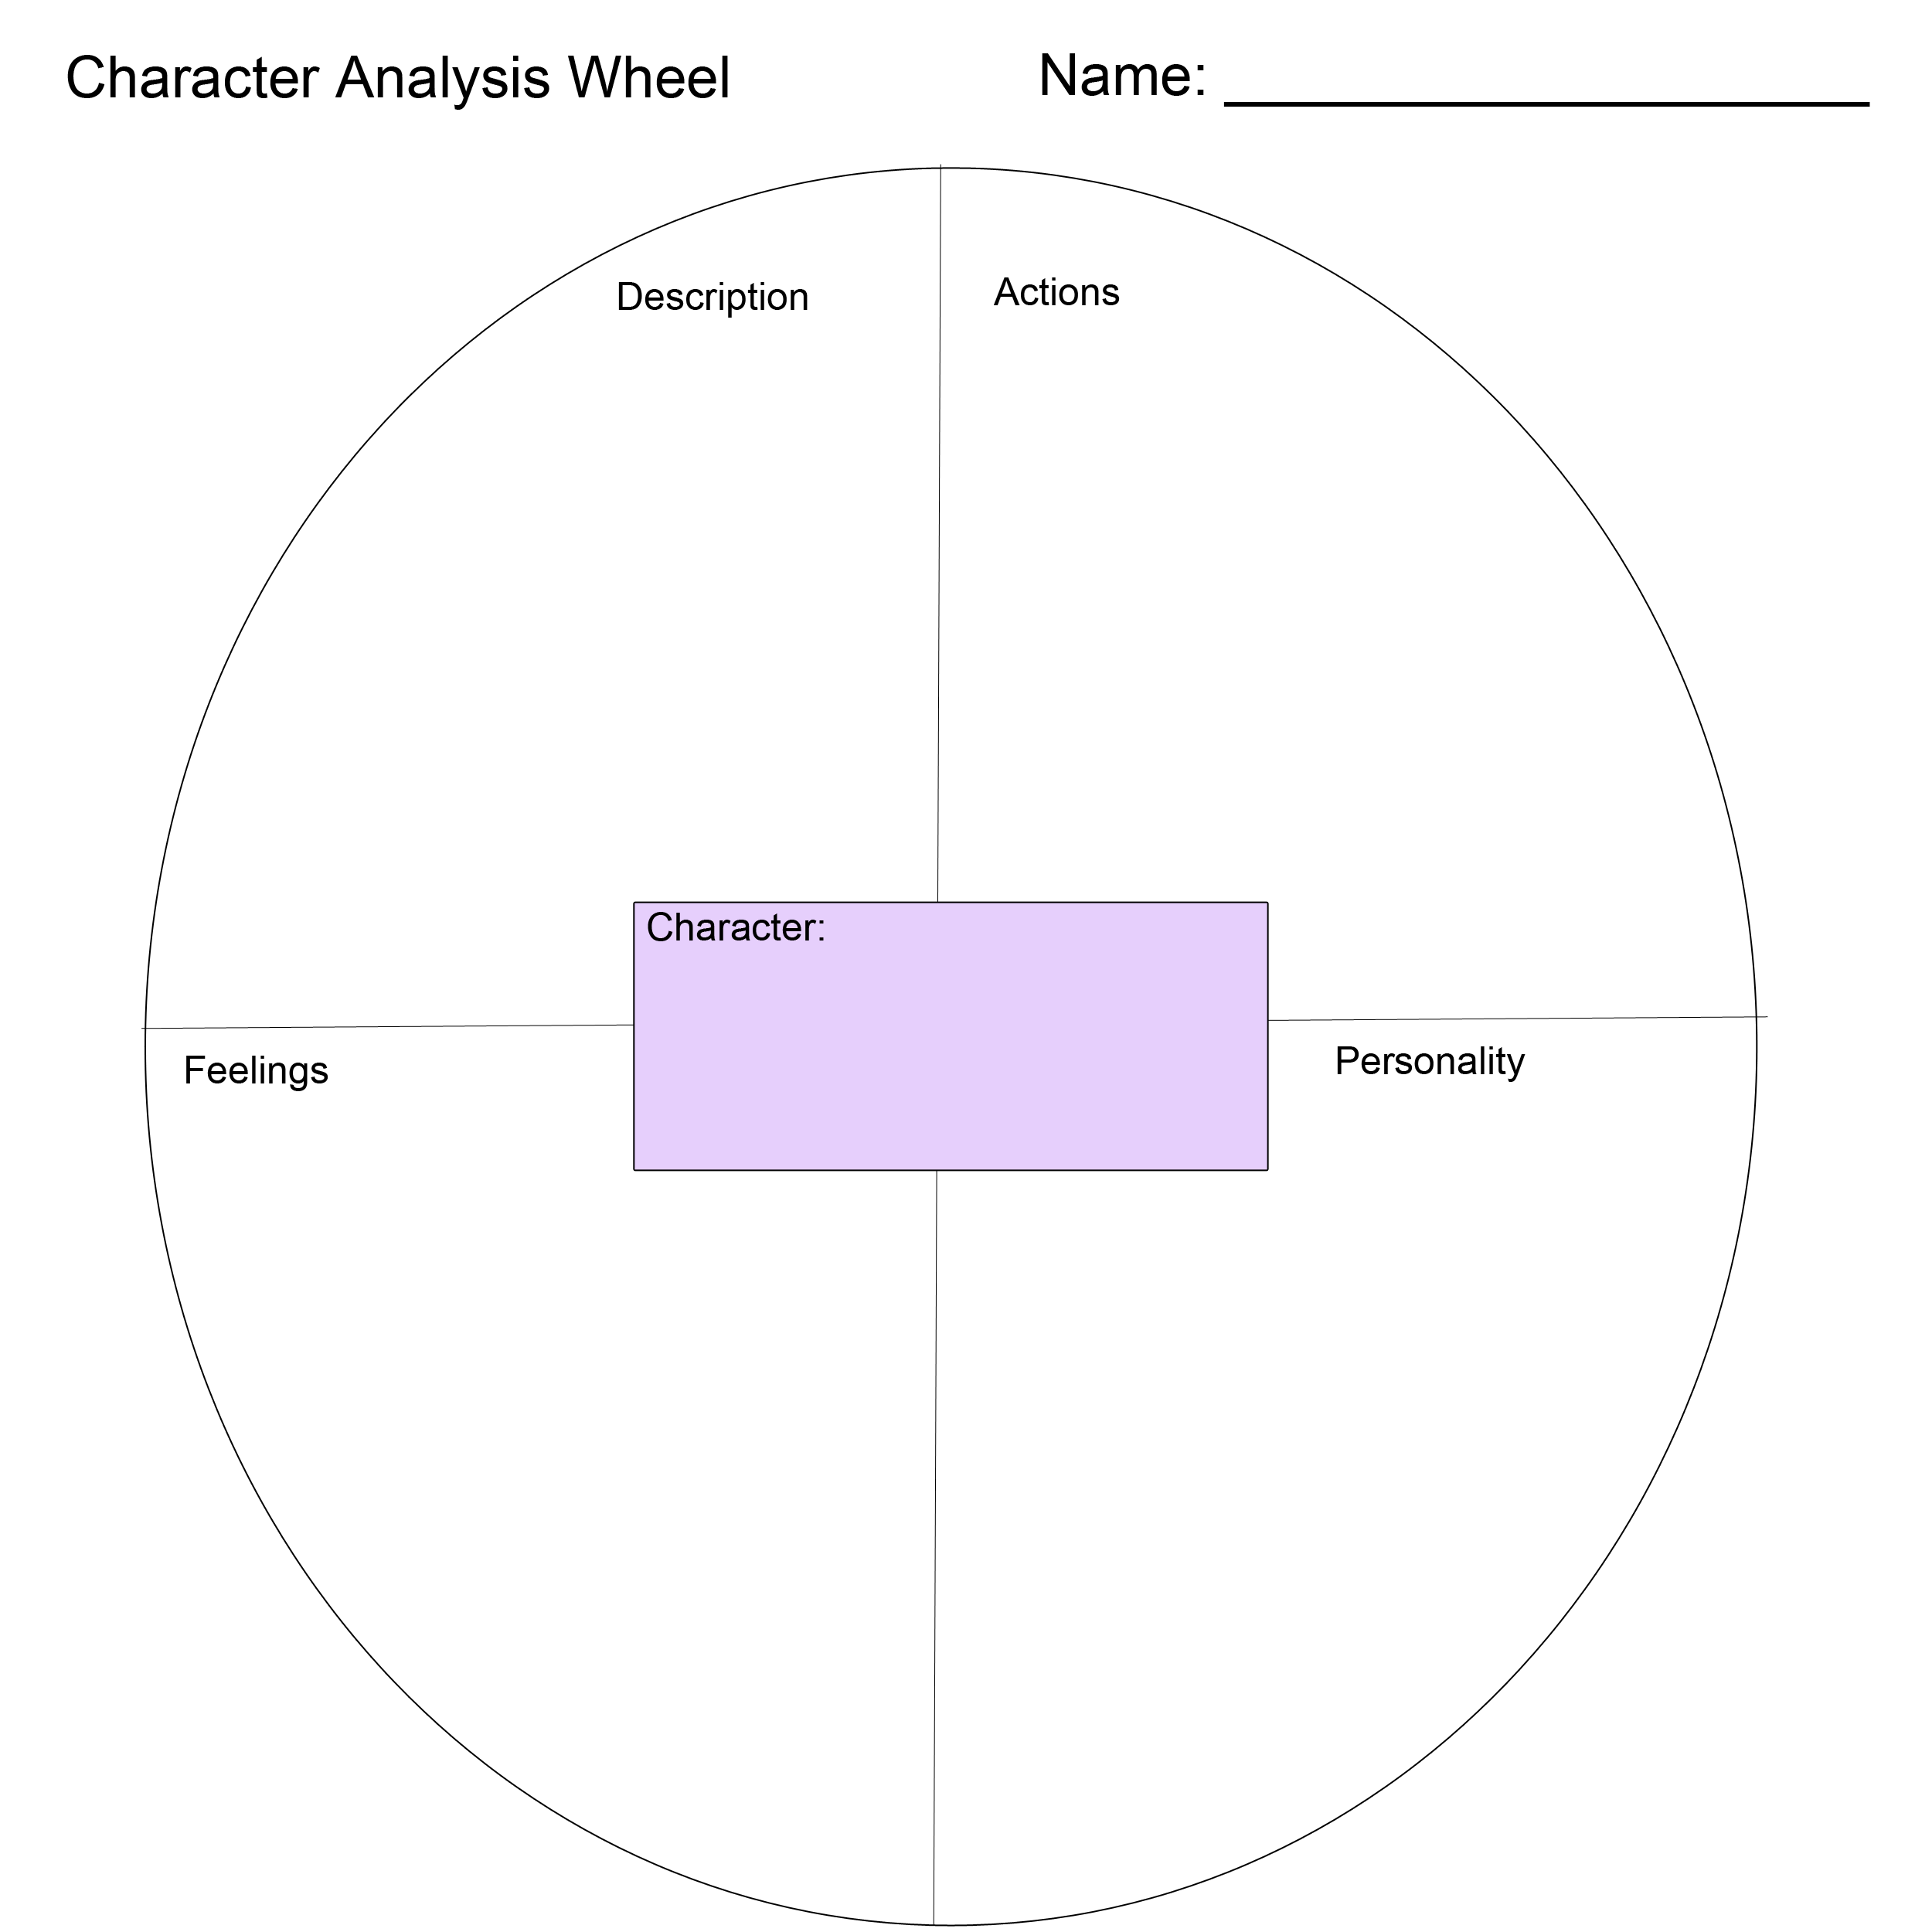
Charlie and the Chocolate Factory
Week 2
#1 Character Analysis:
Draw a picture of Charlie Bucket and write a character analysis.
The character analysis should include a description of what you think Charlie looks like. Please do not describe the characters in the movies. Close your eyes and picture Charlie from the description in the book. What do YOU think he looks like?
What kind of personality does Charlie have?
Use at least 5 words in each section to describe Charlie. Use the Character Analysis Wheel to complete your description.
Be ready to share your analysis with the class on Monday.
Please submit your work to the drop box labeled “Week 2 Assignment”.
Printable Character Analysis Wheel
Notes:
Screen Name: Assignment #1 Character Analysis
Screen Number: 07
Location: within the LMS
Objectives/Standards:
CCSS.ELA-Literacy.RL5.3 – compare and contract characters
Navigation:
Back button will return the learner to screen 06: Assignments page
The next button will take the learner to screen 13: end of the week
“Week 2 Dropbox” button will take the learner to the assignment drop box so they can upload their work
The “PDF” symbol will allow the learner to print the “Character Analysis Wheel”
Interaction:
Learner can click the following buttons:
Next – return to screen 06: Assignments page
Back – go to screen 13: the end of the week
Week 2 Dropbox – go to the assignment dropbox page
PDF – printable version of the Character Analysis Wheel
Multimedia:
PDF version of the Character Analysis wheel will be available to download and print
Script/Notes:
none

Slide 8
Charlie and the Chocolate Factory
Week 2
#2 Visualization:
Draw a picture and write a brief description of Prince Pondicherry’s Palace.
Do you think his design was a good idea? Why or why not? Explain your reasoning in a minimum of 5 sentences.
Be ready to share your vision with the class on Monday.
Please submit your work to the drop box labeled “Week 2 Assignment” by scanning your work or taking a picture of it with your cell phone.
Notes:
Screen Name: Assignment #2 Visualization
Screen Number: 08
Location: within the LMS
Objectives/Standards:
CCSS.ELA-Literacy.RL6.3 – Analyze in detail how a key event or idea is illustrated
Navigation:
Back button will return the learner to screen 06: Assignments page
The next button will take the learner to screen 13: end of the week
“Week 2 Dropbox” button will take the learner to the assignment drop box so they can upload their work
Interaction:
Learner can click the following buttons:
Next – return to screen 06: Assignments page
Back – go to screen 13: the end of the week
Week 2 Dropbox – go to the assignment dropbox page
Multimedia:
none
Script/Notes:
none

Slide 9
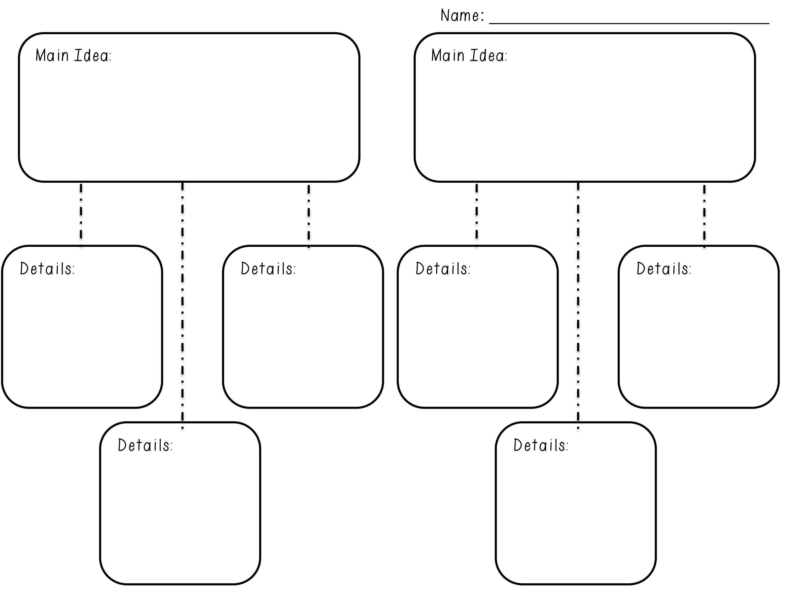
Charlie and the Chocolate Factory
Week 2
#3 Key Ideas:
Answer the following question in at least 5 sentences:
Why do you think Charlie ate his birthday chocolate slowly?
Use the brainstorming chart to right to help generate ideas.
Re-write your ideas into paragraph form. Please use complete sentences!
Printable Key Ideas Worksheet
Notes:
Screen Name: Assignment #3 Key Ideas
Screen Number: 09
Location: within the LMS
Objectives/Standards:
CCSS.ELA-Literacy.RL5.2 – Determine two or more main ideas and explain how they are supported by key details
CCSS.ELA-Literacy.RI6.2 – Determine a central idea of a text and how it is conveyed through particular details
CCSS.ELA-Literacy.RI6.3 – Analyze how a key event or idea is introduced and illustrated in text
Navigation:
Back button will return the learner to screen 06: Assignments page
The next button will take the learner to screen 13: end of the week
“Week 2 Dropbox” button will take the learner to the assignment drop box so they can upload their work
The “PDF” symbol will allow the learner to print the “Key Ideas” worksheet
Interaction:
Learner can click the following buttons:
Next – return to screen 06: Assignments page
Back – go to screen 13: the end of the week
Week 2 Dropbox – go to the assignment dropbox page
PDF – printable version of the Key Ideas Worksheet
Multimedia:
PDF version of the Key Ideas worksheet will be available to download and print
Script/Notes:
none

Slide 10
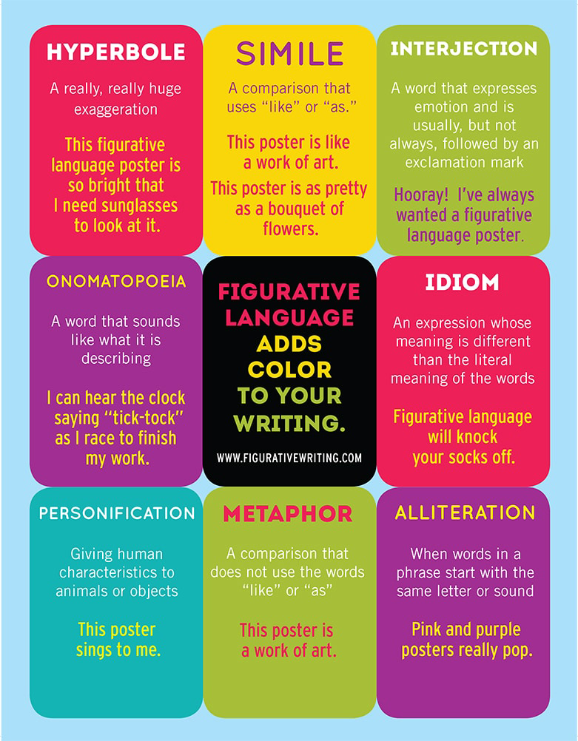
Charlie and the Chocolate Factory
Week 2
#4 Figurative Language:
Create 5 flash cards with similes, metaphors, personification, alliteration, idioms, onomatopoeia, or hyperboles using examples from chapters 1 through 4.
On one side of the card put which form of figurative language you are using.
On the other side, put a quote from the book representing that figurative language. Make a note of the page number the quote came from in parenthesis ().
Notes:
Screen Name: Assignment #4 Figurative Language
Screen Number: 10
Location: within the LMS
Objectives/Standards:
CCSS.ELA-Literacy.RL6.4 – Determine the meaning figurative language
CCSS.ELA-Literacy.L5.5/6.5 – Demonstrate understanding of figurative language
Navigation:
Back button will return the learner to screen 06: Assignments page
The next button will take the learner to screen 13: end of the week
“Week 2 Dropbox” button will take the learner to the assignment drop box so they can upload their work
Interaction:
Learner can click the following buttons:
Next – return to screen 06: Assignments page
Back – go to screen 13: the end of the week
Week 2 Dropbox – go to the assignment dropbox page
Multimedia:
none
Script/Notes:
none

Slide 11
Charlie and the Chocolate Factory
Week 2
#5 Quiz 1:
Click on the candy above to take the quiz. Once your click to start the quiz, you can NOT go back.
Remember, you are only allowed to take a maximum of 4 quizzes this semester.
Notes:
Screen Name: Quiz Assignment
Screen Number: 11
Location: within the LMS
Navigation:
Back button will return the learner to screen 06: Assignments page
The next button will take the learner to screen 13: end of the week
Candy button will take the learner to the quiz start page (quiz example screen 12)
Interaction:
Learner can click the following buttons:
Next – return to screen 06: Assignments page
Back – go to screen 13: the end of the week
Candy – go to quiz
Multimedia:
none
Script/Notes:
none

Slide 12
Quiz #1: Chapters 1 - 4
9. Why did Mr. Wonka fire all the workers in his factory?
a. Some of the workers were spies
b. Some of the workers were stealing money from him.
c. He was too prideful to need help running the factory
d. All of the above
Short Answer
Where did Mr. Bucket work and what was his job?
What are some of the conflicts the Bucket family is facing?
Some words are written in capital letters in Chapter 1. What effect does this have?
Do you think all Grandpa Joe’s stories are true? Why or why not?
Vocabulary Matching
___10. Desperately
___11. Absurd
___12. Nibble
___13. Stammer
___14. Marvelous
___15. Colossal
Ridiculous or doesn’t make sense
Something that is very large
Hesitating and repeating of words or sounds
Extraordinary, extremely good or pleasing
Take small bites out of
Feeling, showing, or involving a hopeless sense.
Multiple Choice
5. Who does Charlie live with?
Mother, Father, Uncle, and Aunt Candy.
Mother, Father, and both sets of Grandparents
Mother, Father, Grandpa Joe, and a little brother
Mother, Father, a Brother, and both sets of Grandparents.
6. How many rooms are in the Bucket family home?
a. Three
b. One
c. Two
d. Five
Long answer (5 pts)
In your own words, compare and contrast the two settings:
Charlie Bucket’s house and Willy Wonka’s Chocolate Factory
(This answer should be at least 10 sentences. Remember to write in full sentences.)
7. What can Charlie see from his house?
a. His School
b. The Chocolate factory
c. The toothpaste factory
d. The garbage dump
8. What did Mr. Wonka do for Prince Pondicherry?
a. Made a chocolate city for him.
b. Made a chocolate car for him.
c. Made a chocolate palace for him.
d. Gave him a life time supply of chocolate.
Submit
Notes:
Screen Name: Quiz
Screen Number: 12
Location: within the LMS
In this module students will:
Read Chapters 3 & 4 of the novel
Add a minimum of 5 words to their word journal in the discussion board
Choose an assignment to complete
Navigation:
Let’s Go button will take you to slide 2
Interaction:
Multimedia:
Script/Notes:

Slide 13
Charlie and the Chocolate Factory
Week 2
Congratulations on completing week 2!
Congratulations on completing Week 2.
The Week 3 course work will open up after our synchronous meeting on Monday.
As always, if you have any questions, please email me with a good time to give you a call.
Notes:
Screen Name: Week End
Screen Number: 13
Location: within the LMS
Navigation:
Back button will return the learner to screen 06: Assignments page
The next button will take the learner to Week 3 Introduction Screen
Interaction:
Learner can click the following buttons:
Next - go to the Week 3 introduction screen
Back – to screen 06: Assignments page
Multimedia:
none
Script/Notes:
none

